Slide 1
Residential Smart Service Solutions
Helping Monterey County Meet SB 1383 Goals
Powered by WM Smart TruckSM Technology

Slide 2

Waste Management’s Residential Smart Services Solution
WM Smart TruckSM Technology:
Provides daily visuals for positive service verification and corrective actions
Informs us about each customer’s needs and behavior to better serve and educate them
Improves safety of our employees and communities
Supports select SB 1383 regulatory requirements
How It Works:
Video: See It In Action
Every stop linked to WM customer database
Every cart lift and its contents captured on camera
Images audited for overage and contamination
Notification & education sent to customer

Slide 3
WM Smart TruckSM Technology Provides Added Value
Proactive Customer Service
Facilitates Compliance with SB1383
County Beautification & Litter Abatement
Audits Billing and Service Levels
Service Verification

Slide 4
Proactive Customer Service
Leading Customer Service Indicators
Positive Service Verification
Identify Container Damage
Billing & Service Level Validation
Cart Replacement Trigger

Slide 5
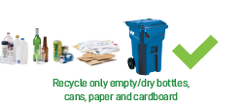
Early Compliance with SB 1383 Route Audit Requirements
Meets Audit Requirement of commingled Recyclables and Organic Materials containers
WM Smart TruckSM technology has ability to visually audit materials each and every collection day
Added Benefit – continuous feedback accelerates behavior change
Education Component
WM Smart TruckSM platform generates electronic notices based on customer behavior
Consistent feedback reinforces proper recycling behavior with single-family, multi-family and commercial customers
Incident photograph re-enforces educational component
Container Contamination Minimization
Notify and educate violators
Impose service charge
Overage: $9.88 per 13-gallon per 13-gal trash bag
Contamination: $28.23 to $30.68
Inadequate MSW cart size leads to overage and contamination
Compliance Reporting
Enhances reporting capabilities to meet jurisdictional annual reporting requirements

Slide 6
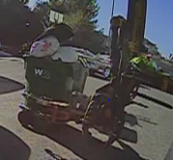
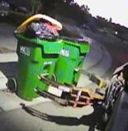
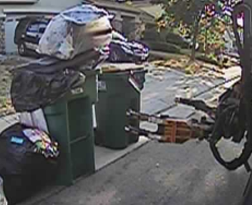
Overage Audit Process
Trained auditor reviews still photo taken prior to cart lift
Overage is recorded if lid is lifted per contract
Overage fee applies to trash, recycling and organics/green waste
Notification to customer via email or text (includes photo of incident)
1
2
3
4
Stockton Overage on July 15, 2020

Slide 7
Contamination Audit Process
Recycling and Organics/Green Waste
1
2
3
4
Established list of not acceptable materials in recyclables & compostables
First review - Trained auditor reviews footage of cart’s content
Second review -Identified contaminant verified by second auditor
Notification to customer via email or text (includes video clip of incident)

Slide 8
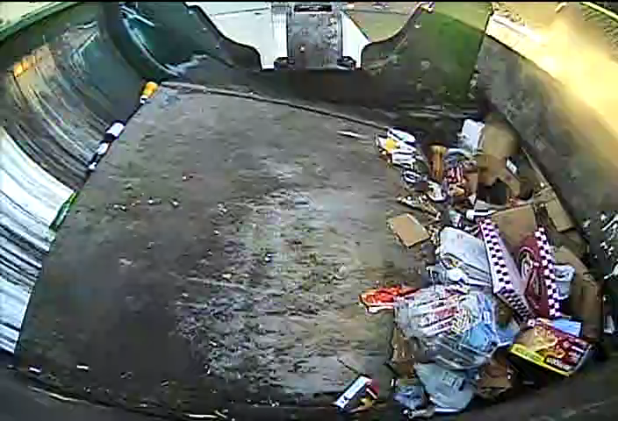
Contamination Video
Recycle Cart Collected
Can you spot the contaminated material?

Slide 9
45-Day Launch – October & November
Focused on education & raising awareness of program – no surcharges during this period
Resident awareness and education
Builds on overage and contamination messaging since 2019
Outreach Campaign in English and Spanish

Slide 10


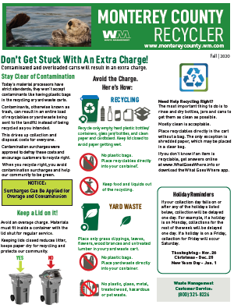
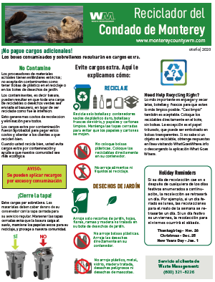
Education to Residents and Businesses
Newsletter included with October 1, 2020 Invoices

Slide 11
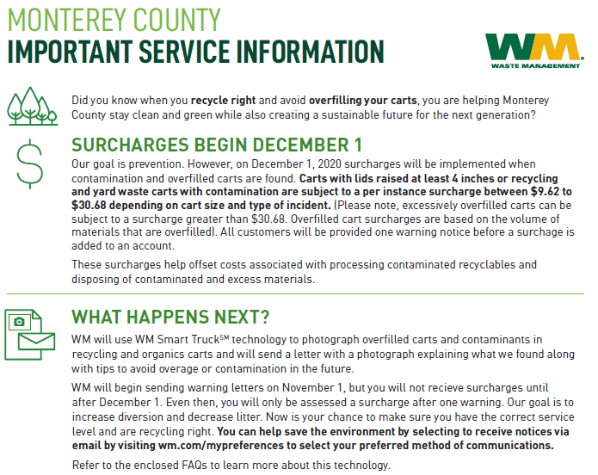
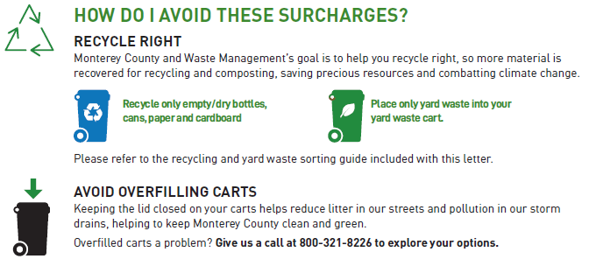
Launch of Customer Communications – November 2020
Mailers to Residents

Slide 12
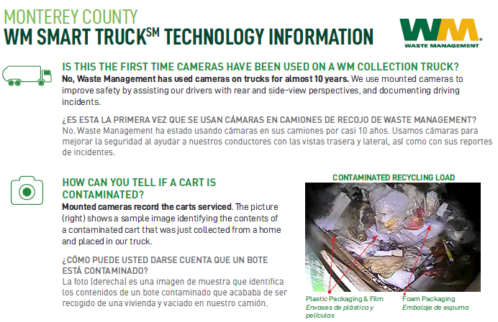
Frequently Asked Questions – Mailed November 2020

Slide 13
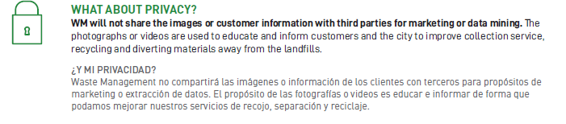
Customer Privacy and Protection – FAQ Flyer

Slide 14
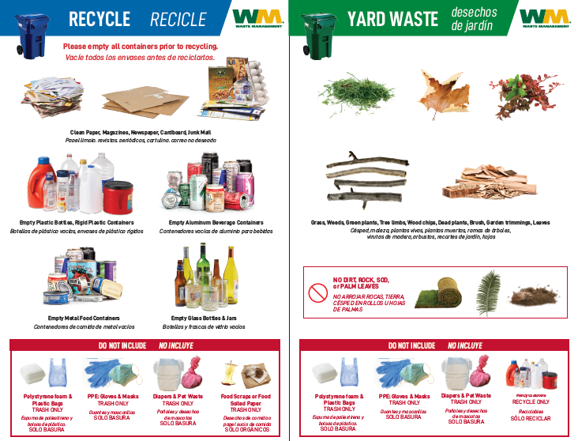
Monterey County Sorting Guide
November 2020

Slide 15
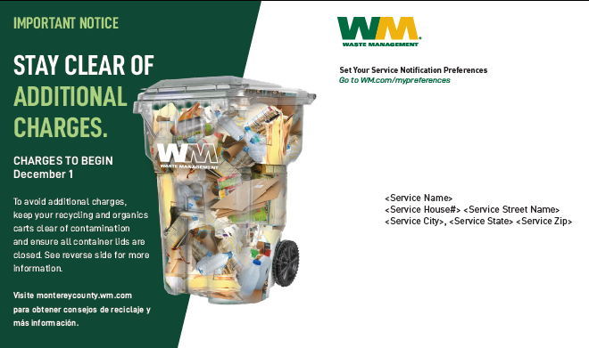
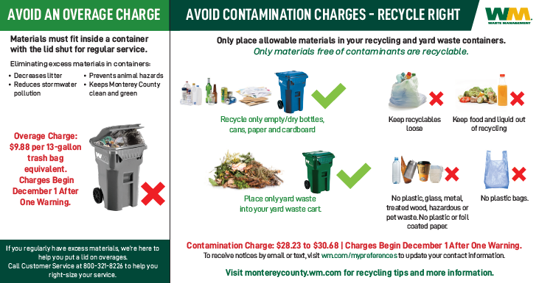
Avoid Overages and Contamination Charges Postcard – November 2020

Slide 16
Next Steps
Provide outreach plan & materials
Present and discuss initial findings
Update City Manager, Council-members & Key Stakeholders
Launch –October & November
Launch Data Evaluation
Go Live – December 1 Continue SB 1383 implementation discussions

Slide 17
Thank you! Questions?

